Slide 1
Visual Attention: What Attract You?
Presenter: Wei Wang
Institute of Digital Media, PKU

Slide 2
Outline
Introduction to visual attention
The computational models of visual attention
The state-of-the-art models of visual attention

Slide 3

What Is Attention?
Attention
The cognitive process of selectively concentrating on one aspect of the environment while ignoring other things.
Referred to as the allocation of processing resources
Cocktail-Party-Effects

Slide 4

Visual Attention: Seeing A Picture…
This picture is from National Gallery Of London

Slide 5
Visual Attention: Seeing A Picture…
This picture is from National Gallery Of London

Slide 6
Visual Attention: Seeing A Picture…
This picture is from National Gallery Of London

Slide 7
Visual Attention: Seeing A Picture…
This picture is from National Gallery Of London

Slide 8
Visual Attention: Seeing A Picture…
This picture is from National Gallery Of London

Slide 9
Visual Attention: Seeing A Picture…
This picture is from National Gallery Of London

Slide 10
Why Does Visual Attention Exist?
Visual attention guilds us to some “salient” regions
Attention is characterized by a feedback modulation of neural activity
Attention is involved in triggering behavior related to recognition and planning
Notes:
Instead of processing the massive sensory input, attention guilds us to some “salient” regions to perform a rapid serials of computationally less demanding, localized visual analysis problem
Attention is characterized by a feedback modulation of neural activity which is believed to be essential for binding the different visual attributes of an object
Attention is involved in triggering behavior related to recognition and planning

Slide 11
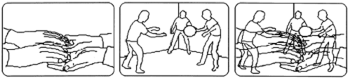
Types of Visual Attention
Location-based attention
Involving selecting a stimulus on the basis of its spatial location, generally associating with early visual processing
Feature-based attention
Directing attention to a feature domain, such as color or motion, to enhance the processing of that feature
Object-based attention
Attend to an object which is defined by a set of features at a location

Slide 12
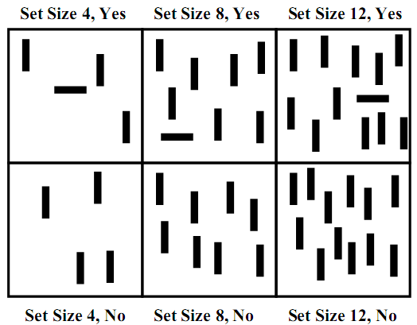
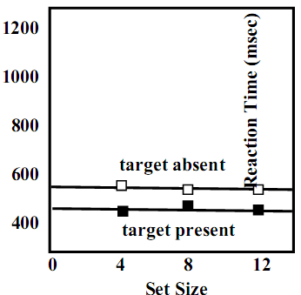
Visual Search
Visual search: the observer is looking for one target item in a display containing some distracting items
The efficiency of visual search is measured by the slope of Reaction time – set size
Wolfe J. “Visual Attention”
Notes:
1.Visual search: an efficient means to understand spatial attention
2.Different levels of preattentive guidance are reflected by the slope of Reaction Time – set size function
3. Reaction time (RT),is the elapsed time between the presentation of a sensory stimulus and the subsequent behavioral response

Slide 13










Preattentive Visual Features

Slide 14
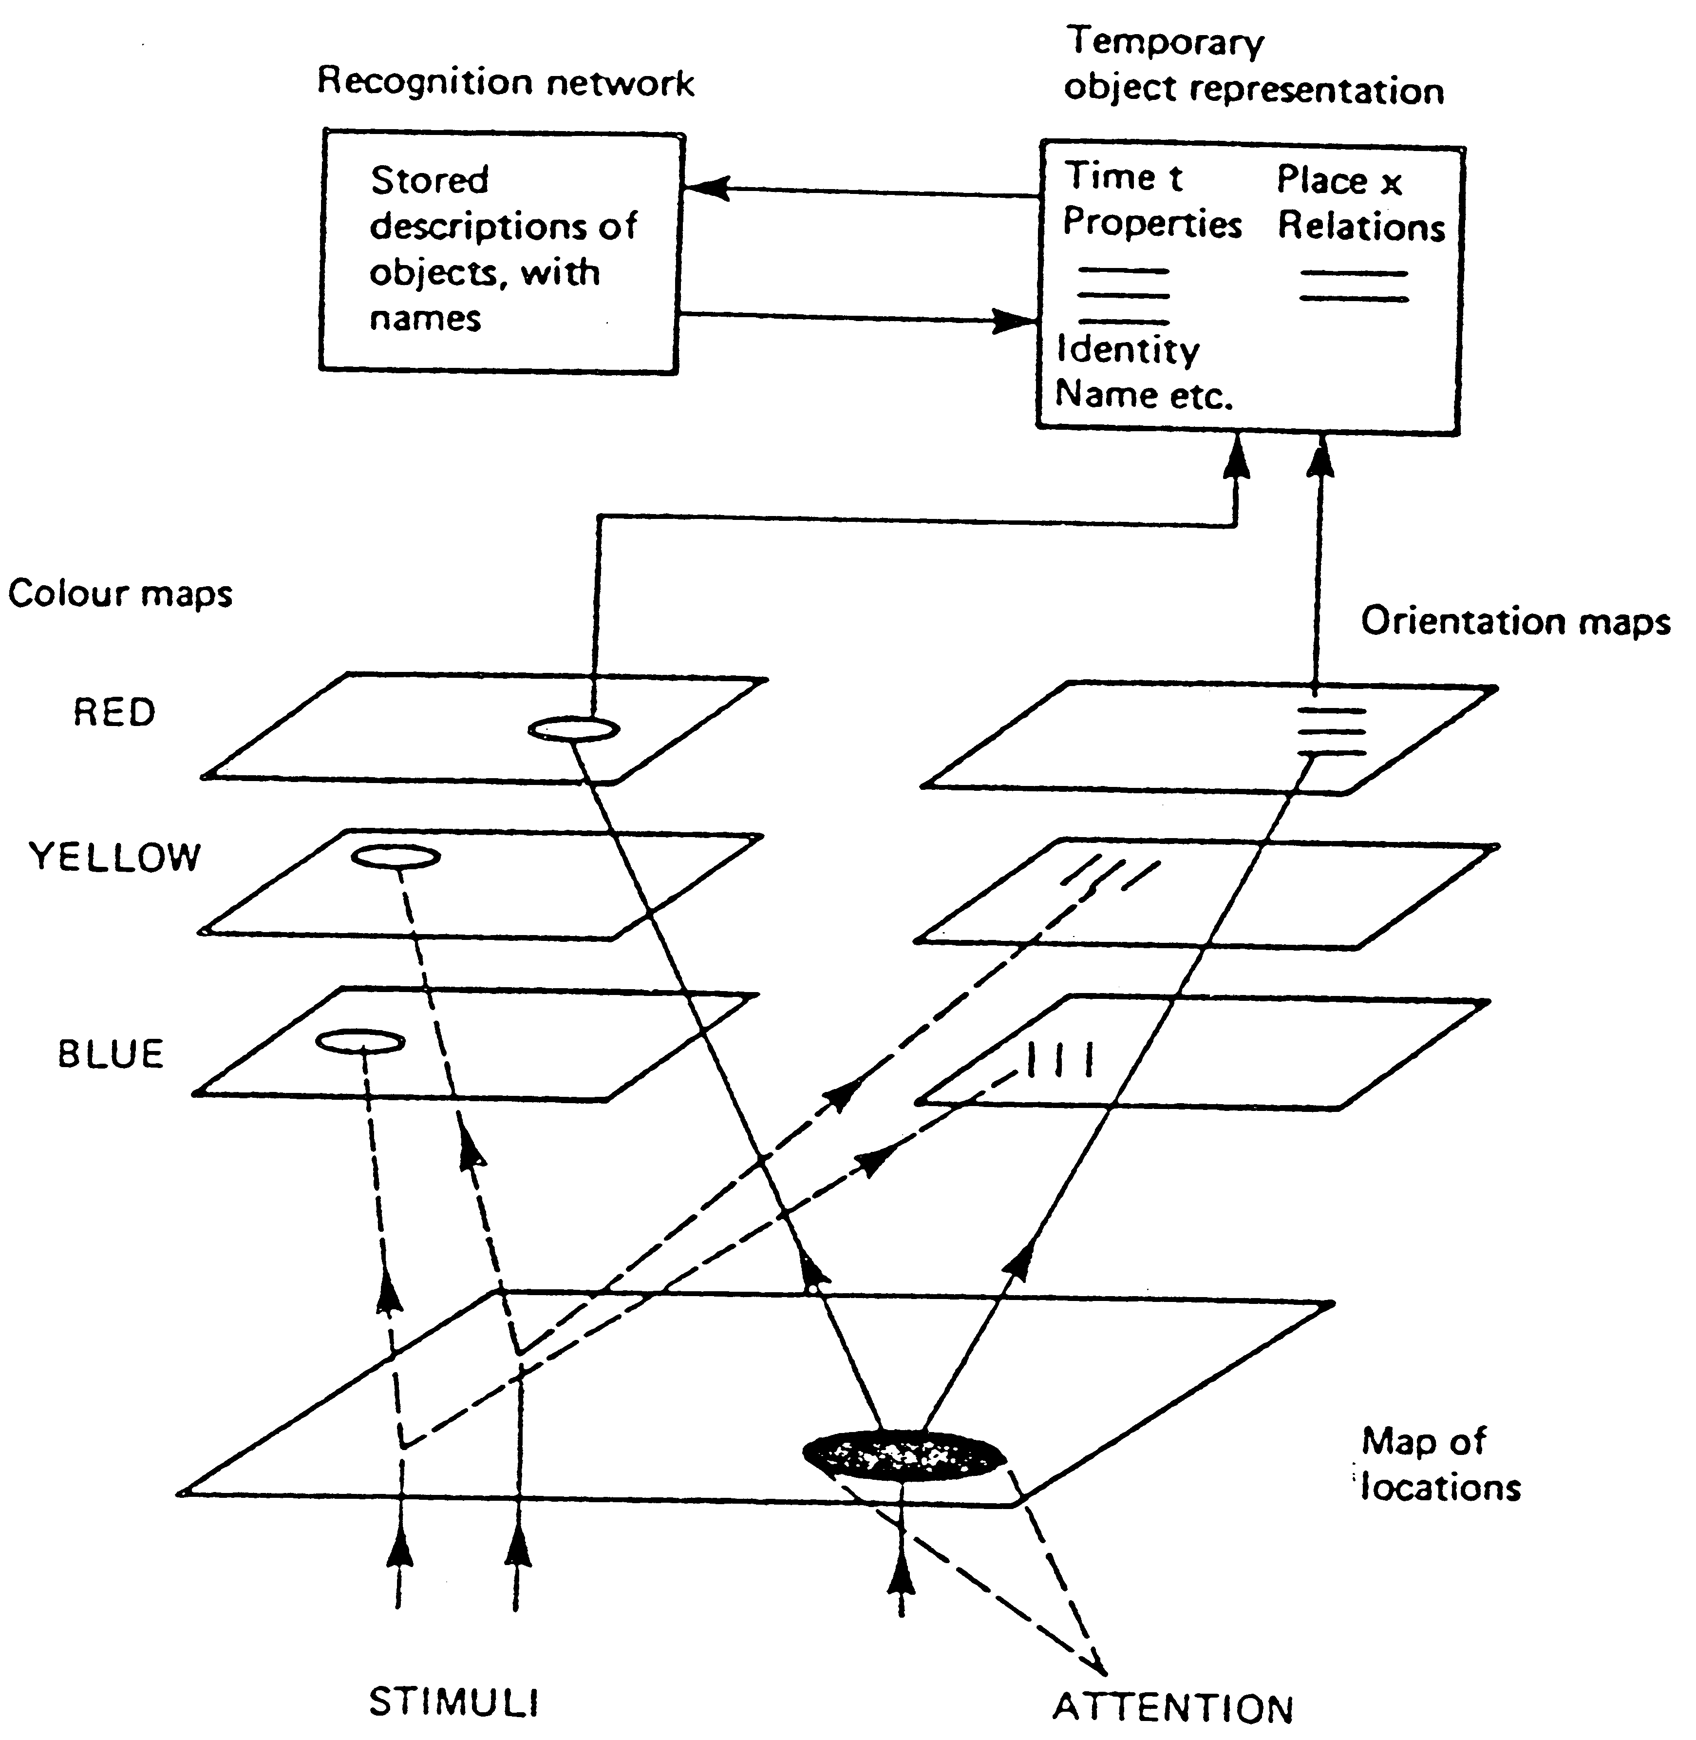
Feature Integration Theory
How do we discriminate them?
“Conjunction search revisited”, Treisman and Sato, 1990.
Notes:
According to Treisman, in a first step to visual processing, several primary visual features are processed and represented with separate feature maps that are later integrated in a saliency map that can be accessed in order to direct attention to the most conspicuous areas.

Slide 15
Inhibition Of Return (IOR)
Observation
The speed and accuracy of detecting an object are first briefly enhanced after the object is attended, then the speed and accuracy are impaired.
Conclusion
IOR promotes exploration of new, previously unattended objects in the scene during visual search by preventing attention from returning to already-attended objects.

Slide 16
Outline
Introduction to visual attention
The computational models of visual attention
The state-of-the-art models of visual attention

Slide 17
Motivation
An important challenge for computational neuroscience
Potential applications for computer vision
Surveillance
Automatic target detection
Scene categorization
Object recognition
Navigational aids
Robotic control
…

Slide 18
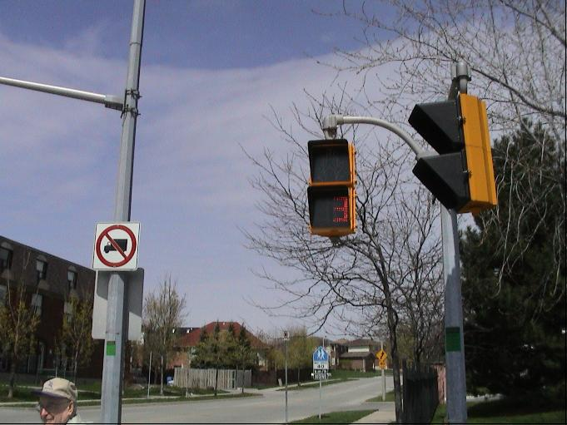
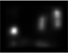
Basic Structure of Computational Models
Computational model
Images/Videos
Input
Output
Saliency map
(and others)

Slide 19
Image/Video Data Set and Eye-Tracking Data
D.B. Bruce’s data set
120 color images including indoor and outdoor scenes
Record 20 subjects’ fixation data
W. Einhauser’s data set
108 gray images of natural scenes and each image has nine versions
Record 7 subjects’ fixation data
L. Itti’s data set
50 video clips including outdoor scenes, TV broadcast and video games
Record 8 subjects’ fixation data
Notes:
Laurent Itti from USC (Univ. of Southern California)

Slide 20
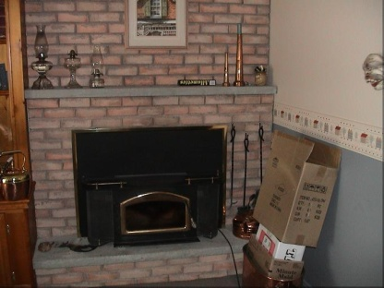





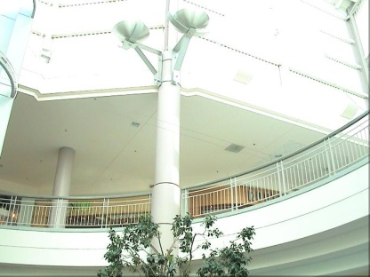

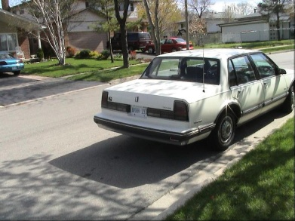
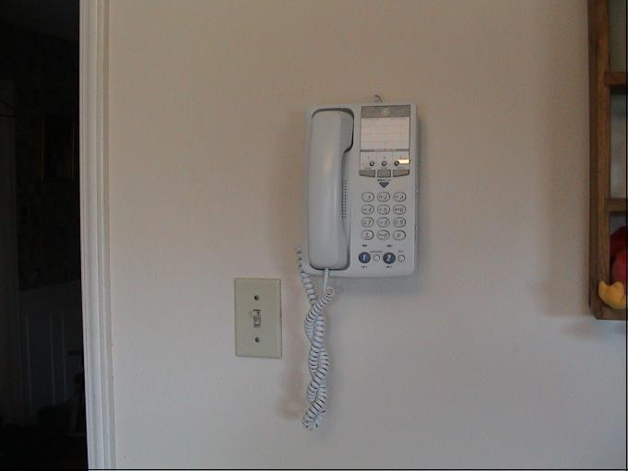
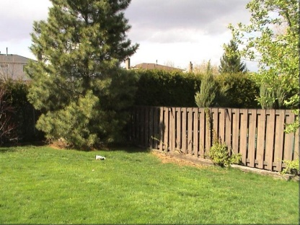
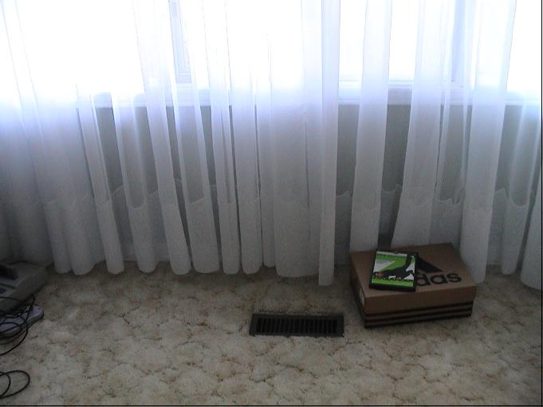
Samples from Bruce’ s Data Set

Slide 21
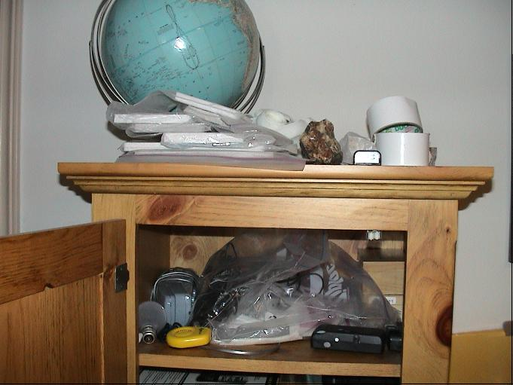
An Example
Eye-tracking data (original image)

Slide 22
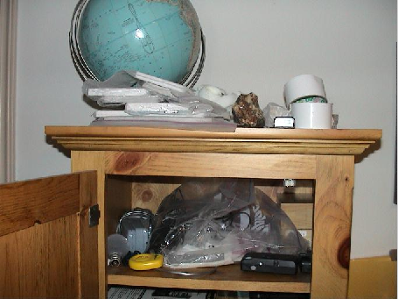
Scanpath Demo

Slide 23
An Example
Eye-tracking data (fixations)

Slide 24

An Example
Eye-tracking data (density map)

Slide 25
The Form of Fixation Data
10 fixation points
Maximum gap between gazepoints (seconds): 0.500
Minimum fixation time (seconds): 0.200
Minimum fixation diameter (pixels): 50
fixation number , x position, y position, begin time (s), end time (s), duration(s)
1. 449, 270, 0.150, 0.430, 0.280
2. 361, 156, 0.500, 0.791, 0.291
3. 566, 556, 1.001, 1.231, 0.230
4. 400, 548, 1.291, 1.562, 0.271
5. 387, 619, 1.592, 1.792, 0.200
6. 698, 672, 1.892, 2.093, 0.201
7. 730, 528, 2.133, 2.493, 0.360
8. 719, 288, 2.663, 3.094, 0.431
9. 805, 295, 3.134, 3.535, 0.401
10. 451, 287, 3.635, 3.935, 0.300

Slide 26

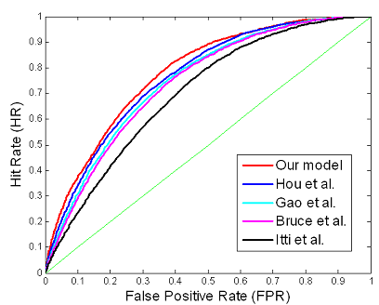
Evaluation Method
Qualitative comparison
Quantitative comparison
ROC curve
y-axis: TPR = TP/P
x-axis: FPR = FP/N

Slide 27
Outline
Introduction to visual attention
The computational models of visual attention
The state-of-the-art models of visual attention

Slide 28
General Framework of A Computational Model
Image/Video
Computational Model
Extract visual features
Measurement of Visual Saliency
Normalization
(optional)
Saliency map

Slide 29
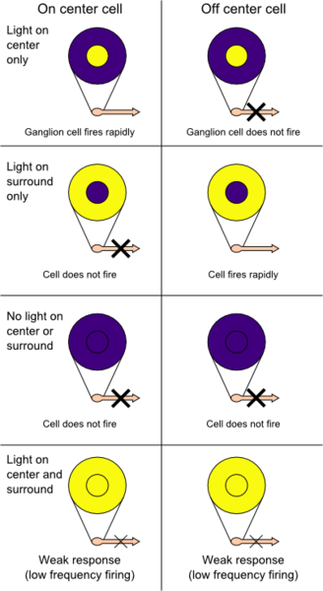
Center-Surround Receptive Field
Receptive field: a region of space in which the presence of a stimulus will alter the firing of that neuron
Receptive field of Retinal ganglion cells
Detecting contrast
Detecting objects’ edges

Slide 30
L. Itti, C. Koch, E. Niebur (Caltech)
Center-surround model
The most influential biologically-plausible saliency model
Color
Intensity
Orientation
Saliency Map
“A model of saliency-based visual attention for rapid scene analysis”, PAMI 1998

Slide 31
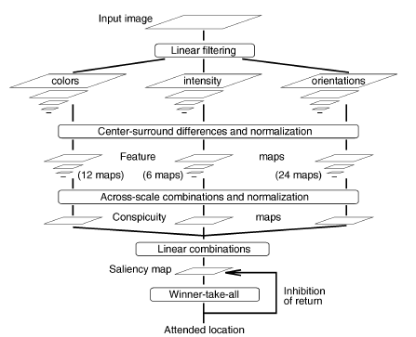
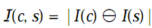
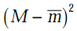
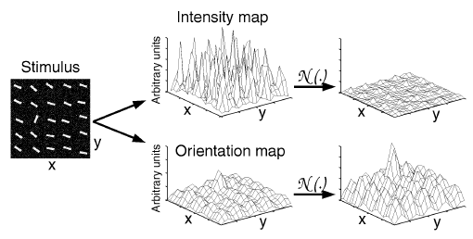

Slide 32
D.B. Bruce, J.K. Tsotsos (York Univ.CA)
Information-driven model
Define visual saliency as
assuming the features are independent to each other
“Saliency based on information maximization”, NIPS 2005

Slide 33
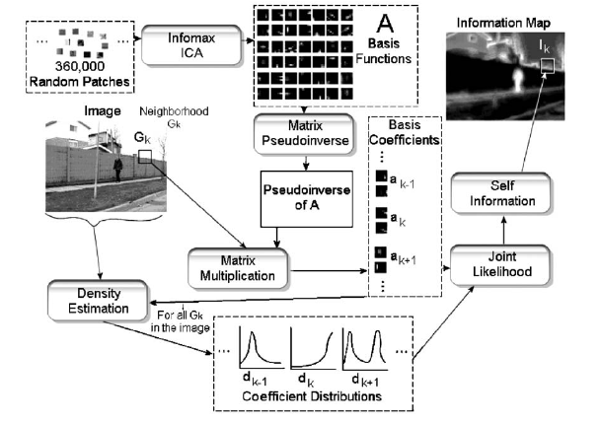

Slide 34
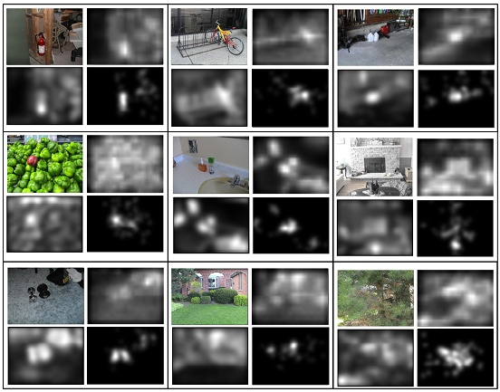
Experimental Results

Slide 35
Dashan Gao, et al. (UCSD)
For the center-surround differencing proposed by L. Itti
Fail to explain those observations about fundamental computational principles for neural organization
Fail to reconcile with both non-linearities and asymmetries of the psychophysics of saliency
Fail to justify difference-based measures as optimal in a classification sense
“Discriminant center-surround hypothesis for bottom-up saliency”, NIPS 2007

Slide 36
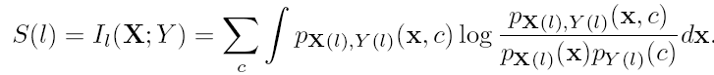
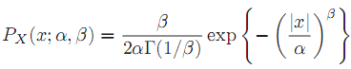

Discriminant Center-Surround Hypothesis
Discriminant center-surround hypothesis
This processing is optimal in a decision theoretic sense
Visual saliency is quantified by the mutual information between features and label
Generalized Gaussian Distribution for

Slide 37
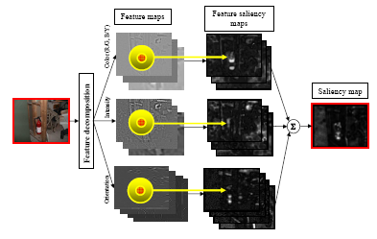
Framework and Experimental Results

Slide 38
Xiaodi Hou, Liqing Zhang (Shanghai Jiaotong, Univ.)
Feature-based attention: V4 and MT cortical areas
Hypothesis
Predictive coding principle: optimization of metabolic energy consumption in the brain
The behavior of attention is to seek a more economical neural code to represent the surrounding visual environment
“Dynamic visual attention searching for coding length increments”, NIPS 2008

Slide 39
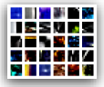
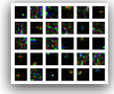
Theory
Sparse representation: V1 simple cell

Slide 40
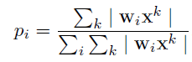
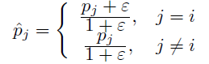
Theory
Incremental Coding Length (ICL): aims to optimize the immediate energy distribution in order to achieve an energy-economic representation of its environment
Activity ration
New excitation
Notes:
pi: the probability of feature activity

Slide 41
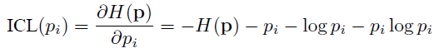
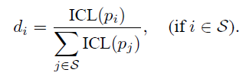
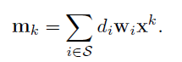
Theory
ICL
Saliency map

Slide 42
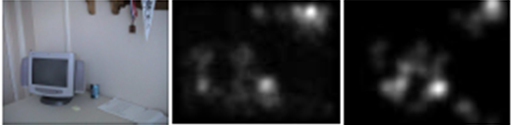

Experimental Results
Original Images
Hou’s results
Density maps
Itti et al. | Bruce et al. | Gao et al. | Hou et al.
0.7271 | 0.7697 | 0.7729 | 0.7928

Slide 43
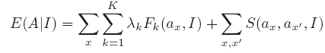
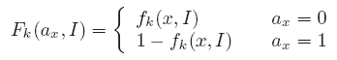
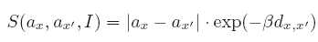
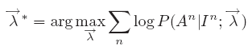
Tie Liu, Jian Sun, et al. (MSRA)
Conditional Random Field (CRF) for salient object detection
CRF learning
“Learning to detect a salient object”, CVPR 2007

Slide 44
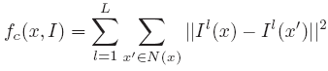
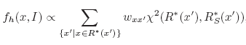
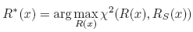
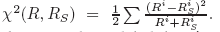
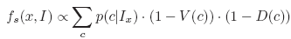
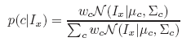
Extract features
Salient object features
Multi-scale contrast
Center-surround histogram
Color spatial-distribution

Slide 45
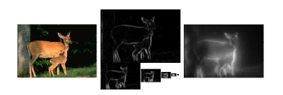
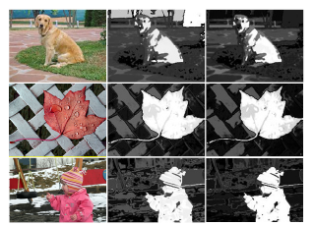
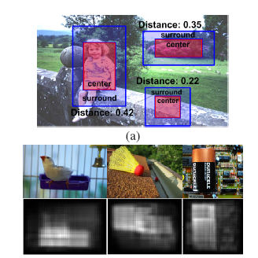
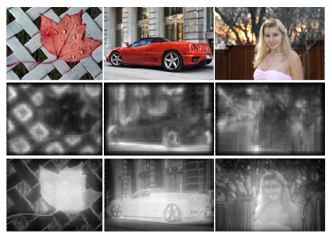
1. Multi-scale contrast
3. Color-spatial distribution
2. Center-surround histogram
4. Three final experimental results

Slide 46
Thanks!

Slide 47
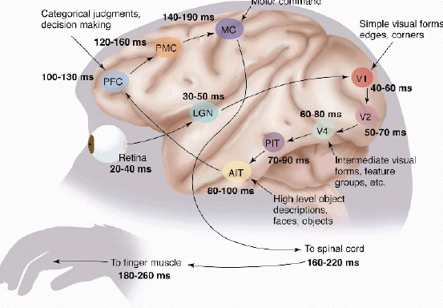
Human Visual Pathway
Cited from Simon Thorpe in ECCV 2008 Tutorial

